Slide 1
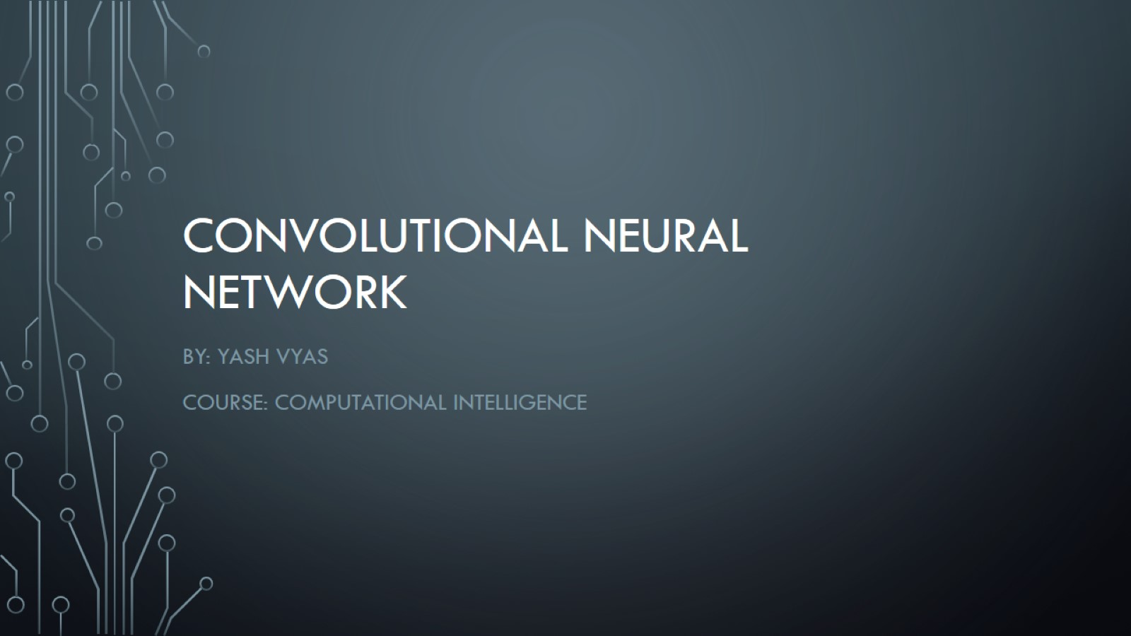
Convolutional Neural Network

Slide 2
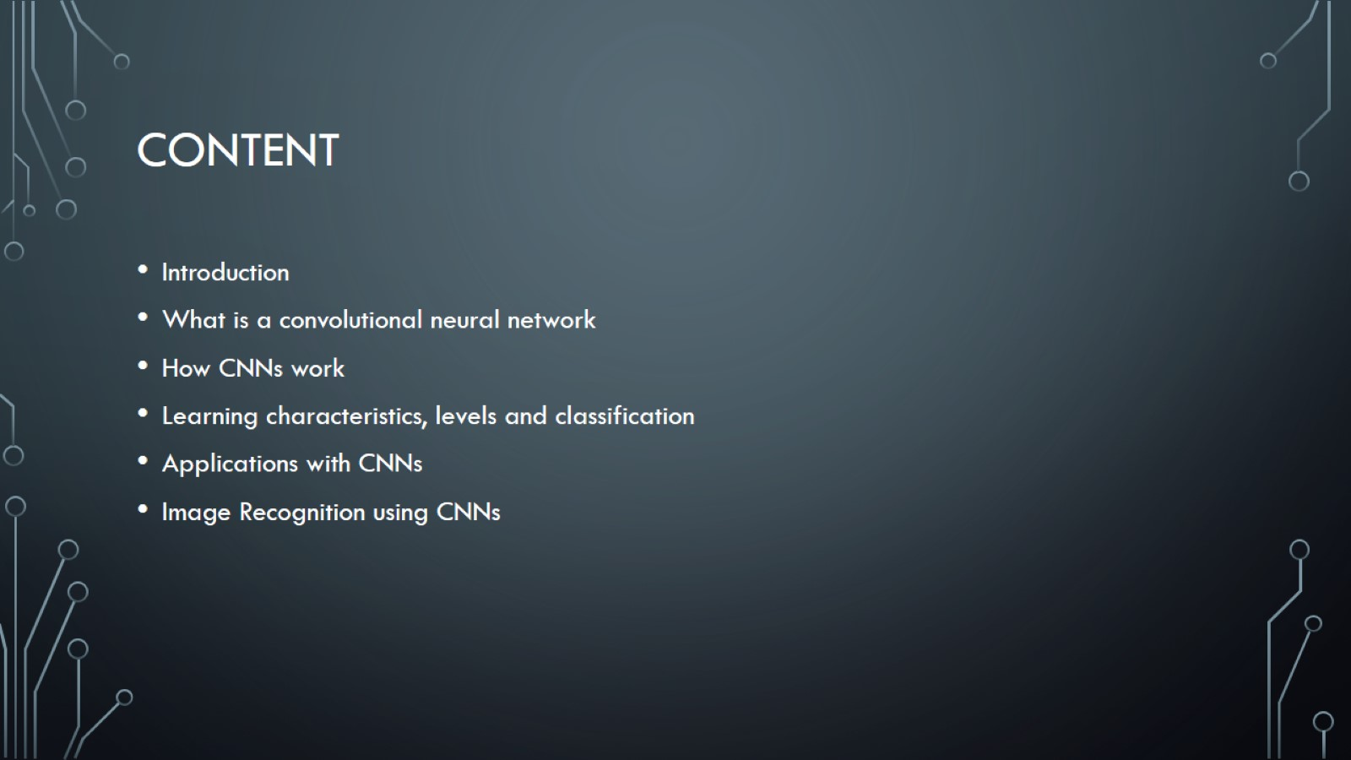
Content

Slide 3
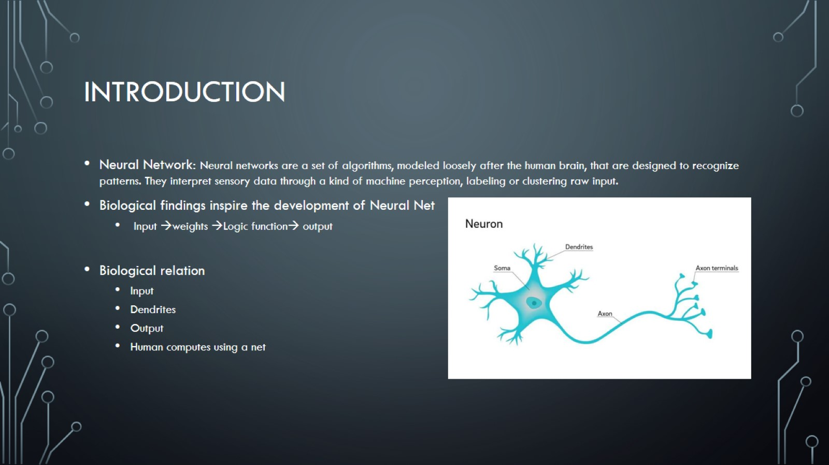
Introduction

Slide 4
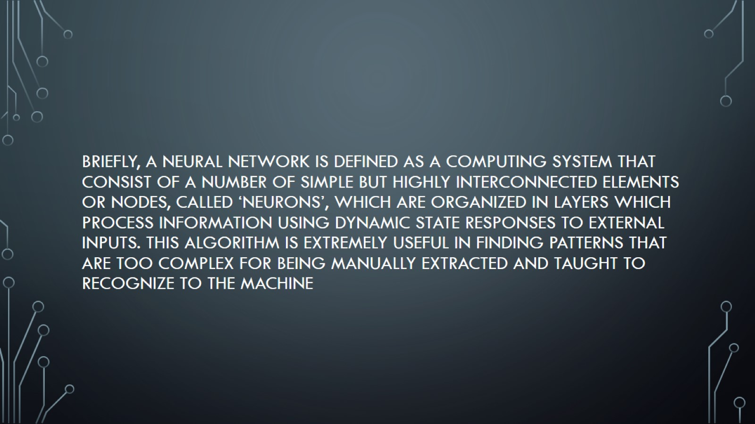
Briefly, a neural network is defined as a computing system that consist of a number of simple but highly interconnected elements or nodes, called ‘neurons’, which are organized in layers which process information using dynamic state responses to external inputs. This algorithm is extremely useful in finding patterns that are too complex for being manually extracted and taught to recognize to the machine

Slide 5
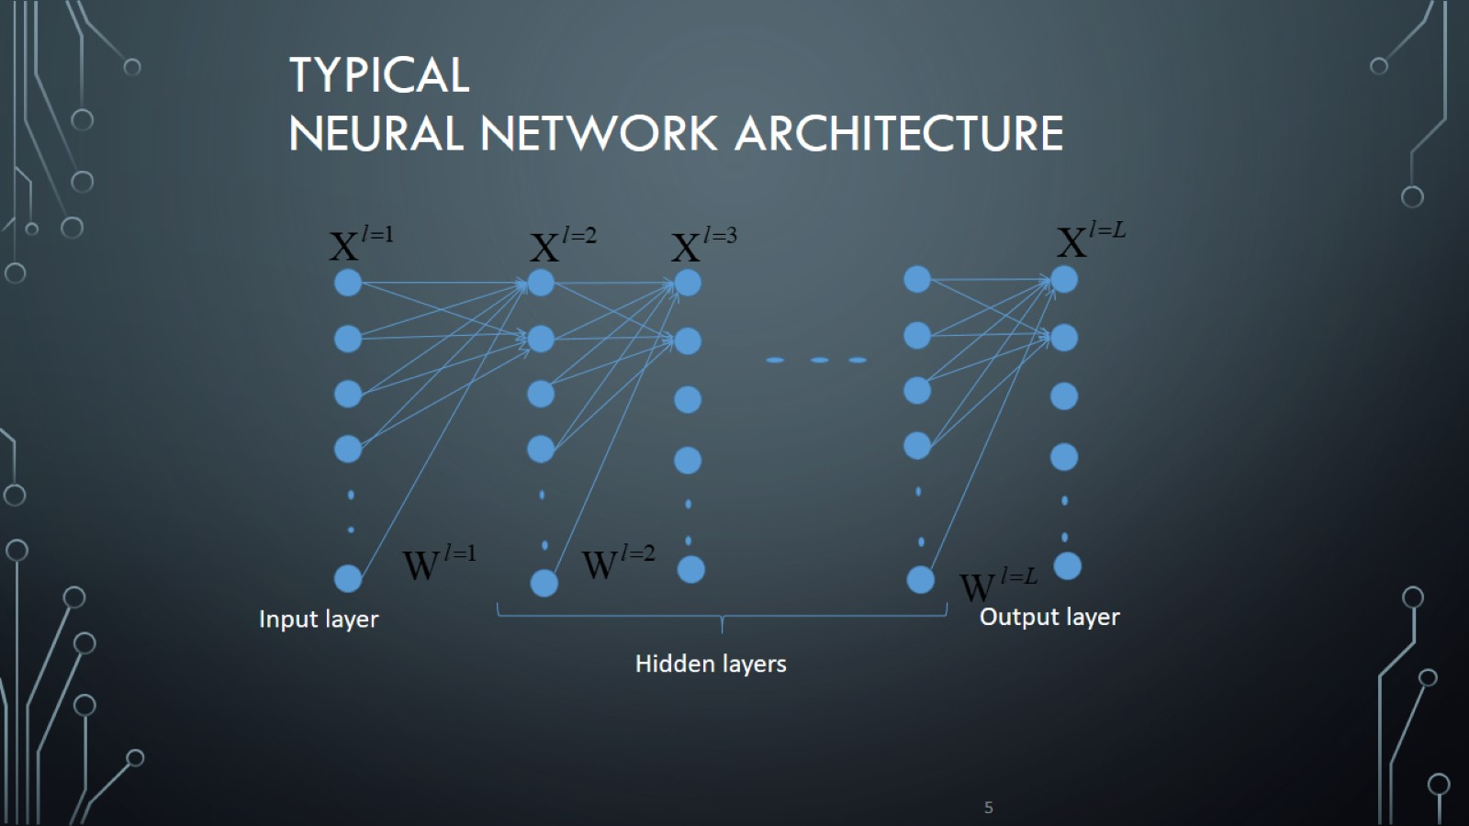
Typical neural network Architecture

Slide 6
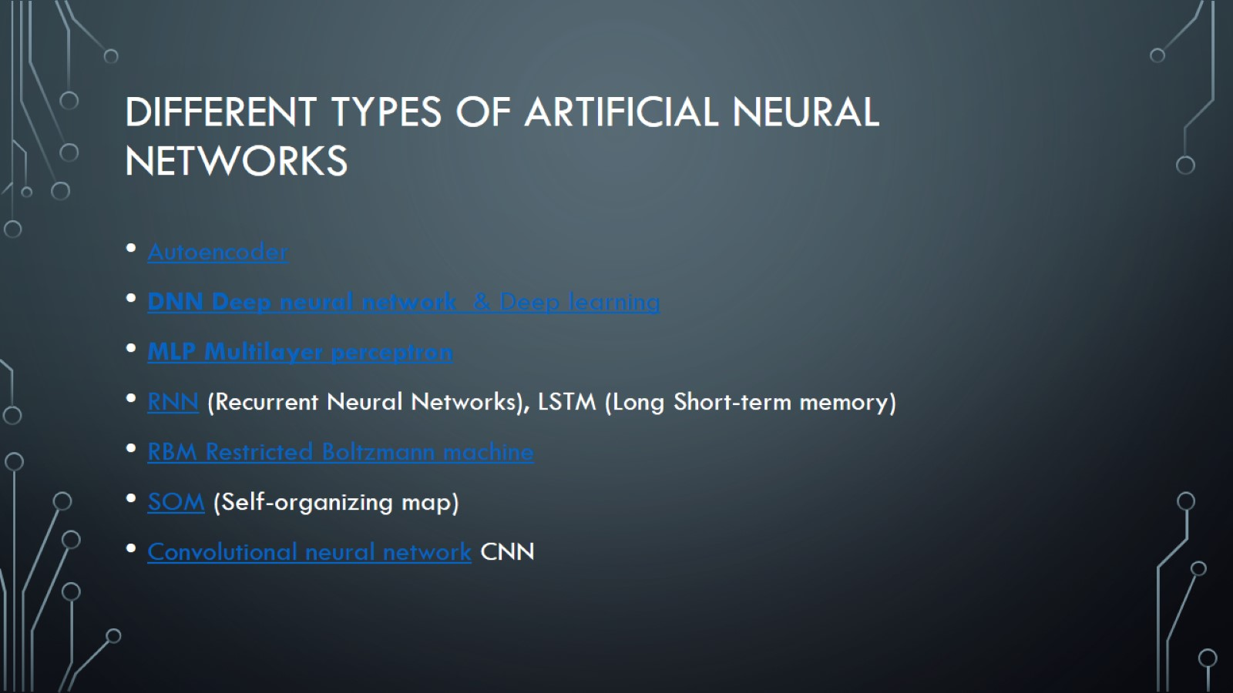
Different types of artificial neural networks

Slide 7
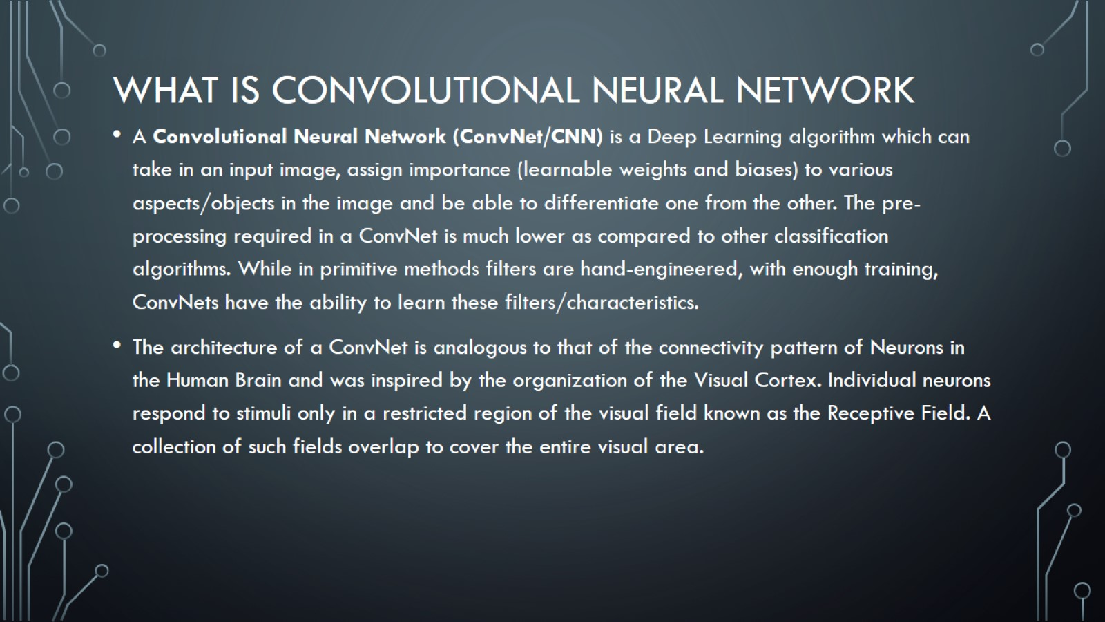
What is Convolutional neural network

Slide 8
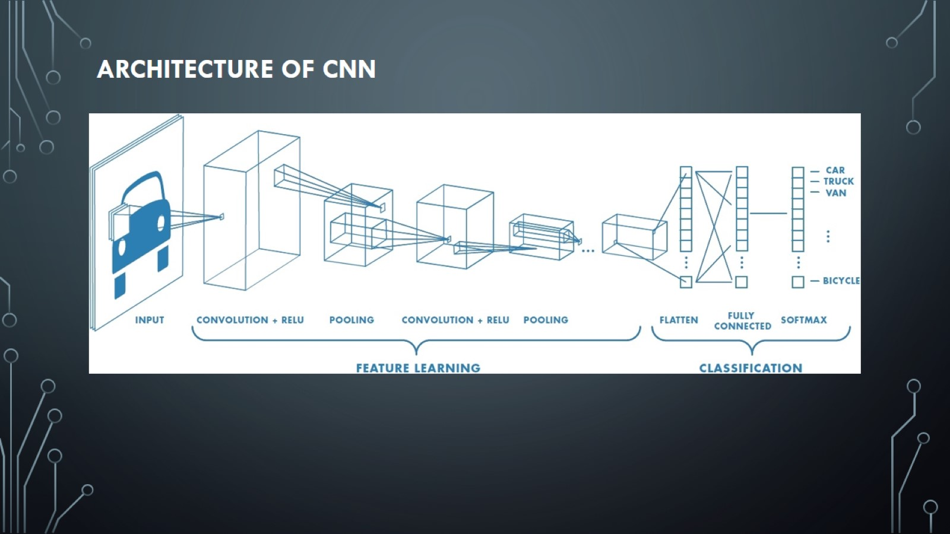
Architecture of Cnn

Slide 9

Layers of cnn

Slide 10
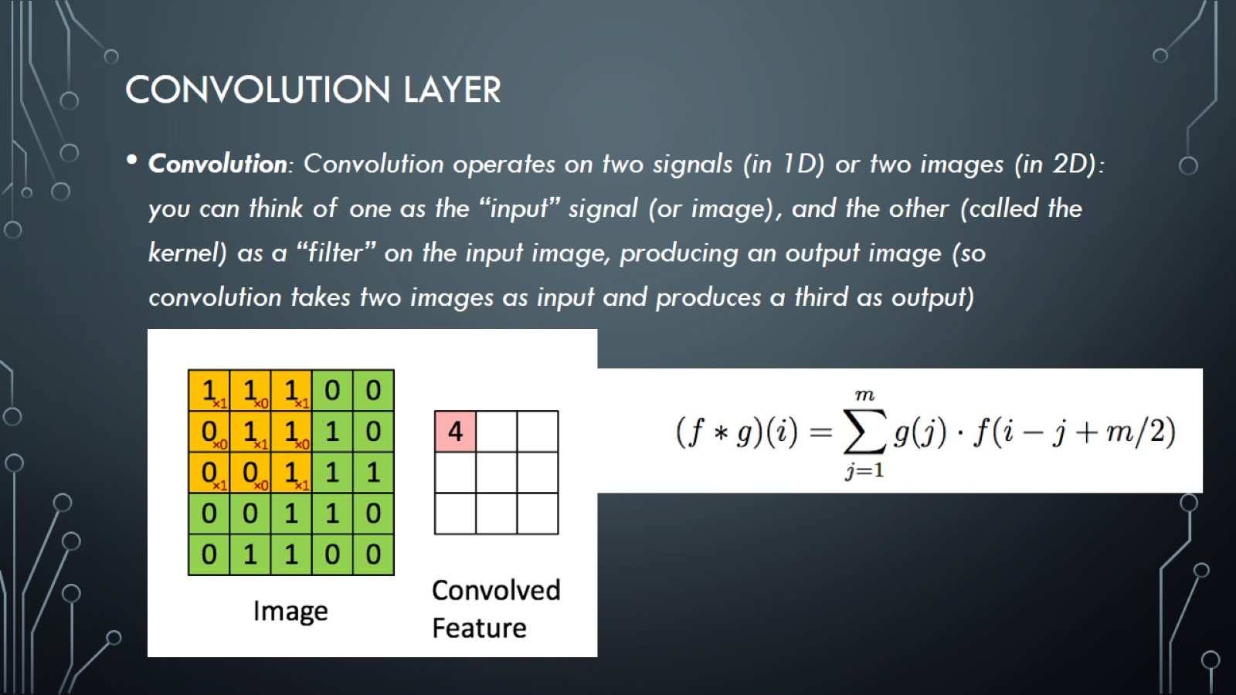
Convolution layer

Slide 11
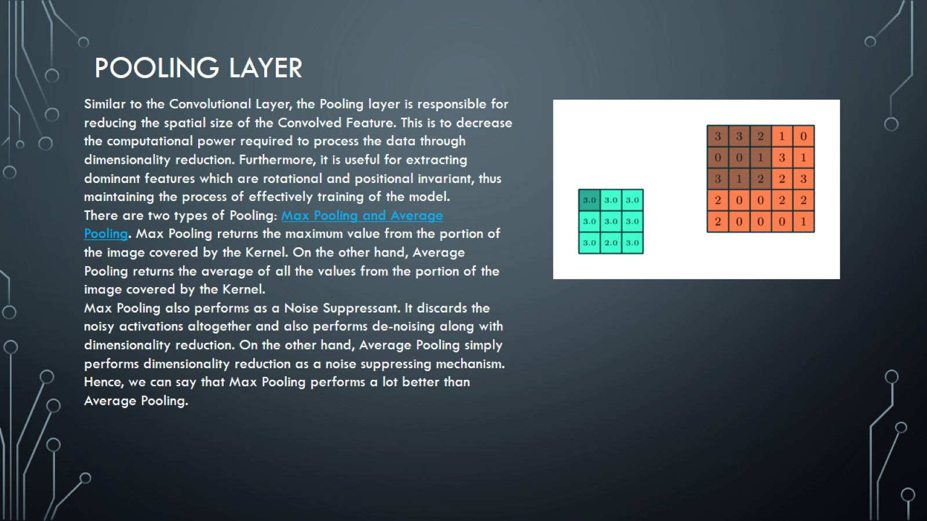
Pooling Layer

Slide 12
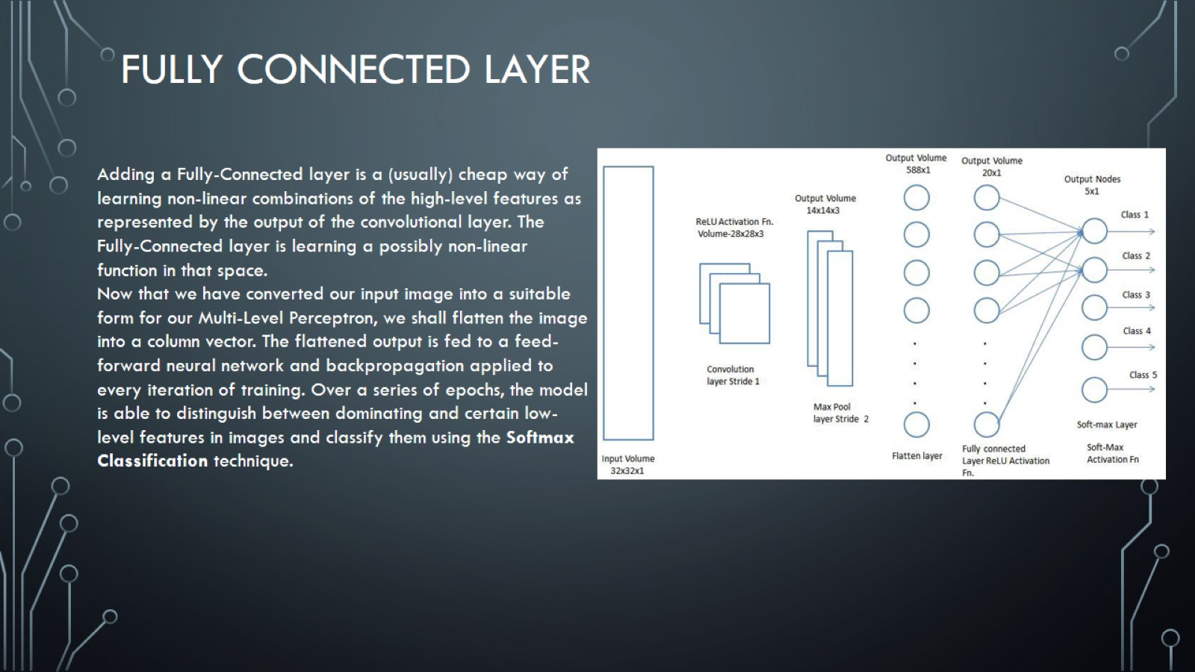
Fully Connected layer

Slide 13
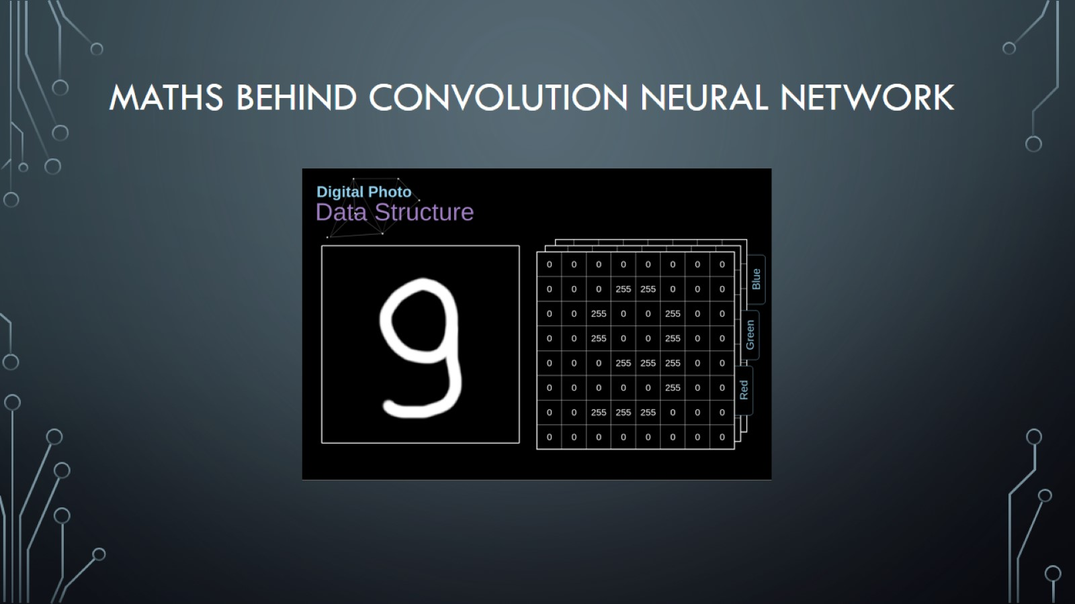
Maths behind Convolution Neural Network

Slide 14
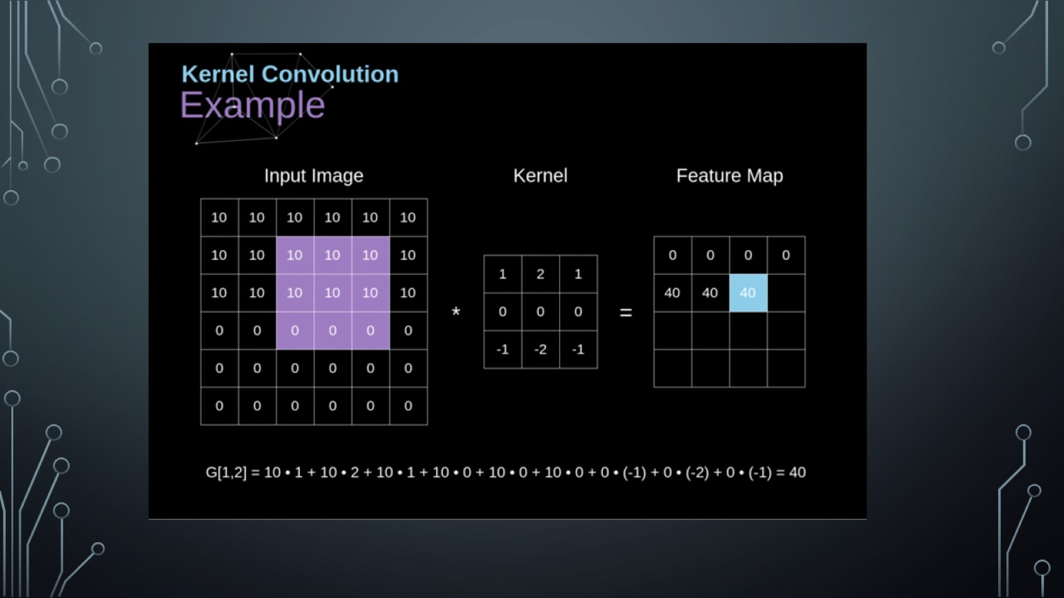

Slide 15


Slide 16
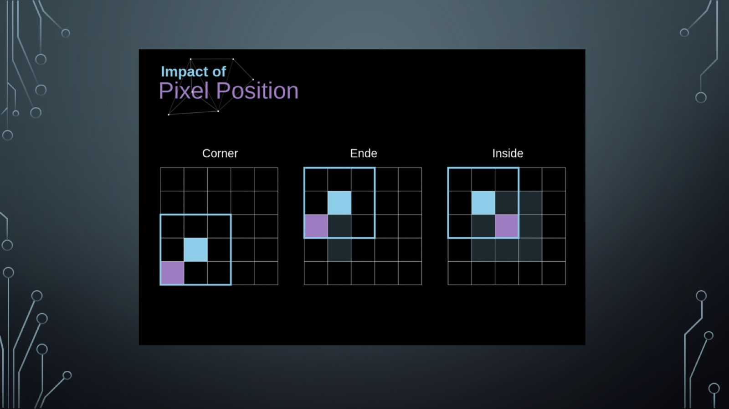

Slide 17
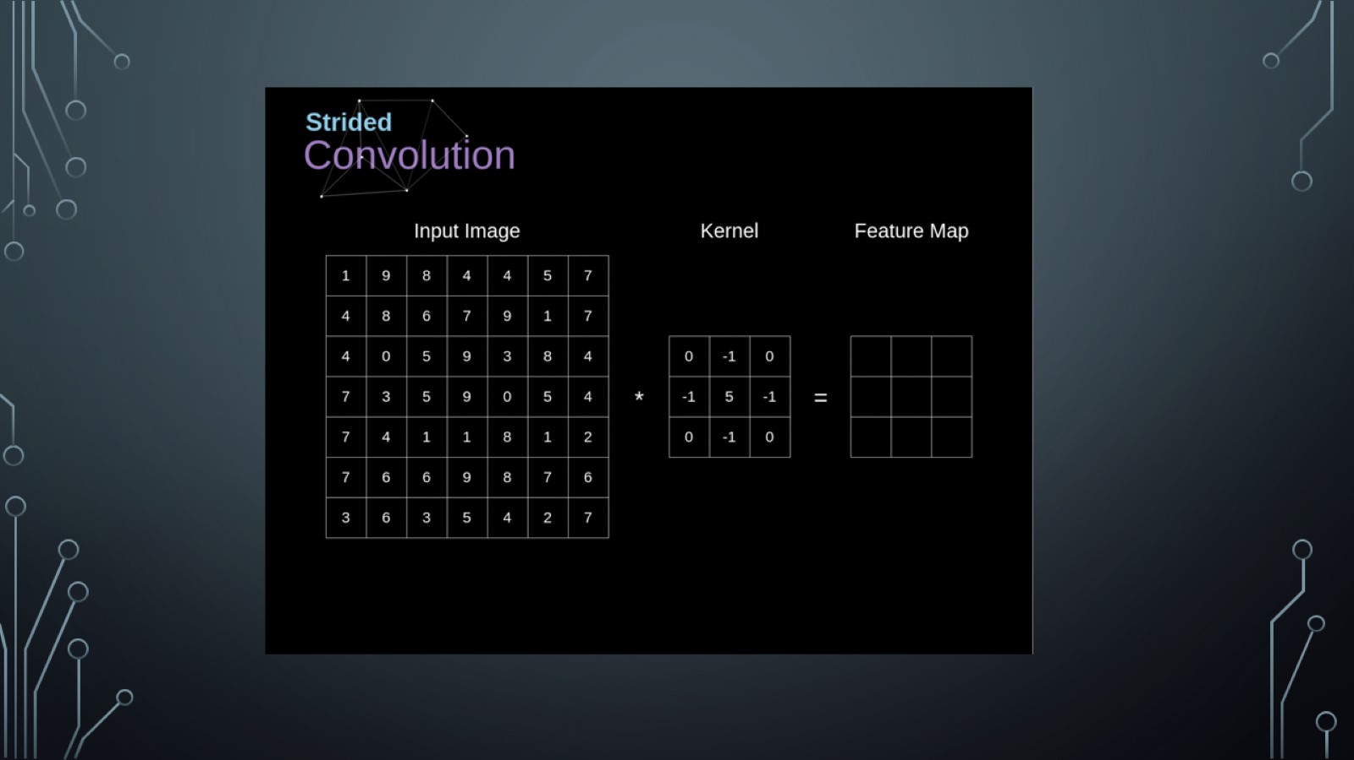

Slide 18
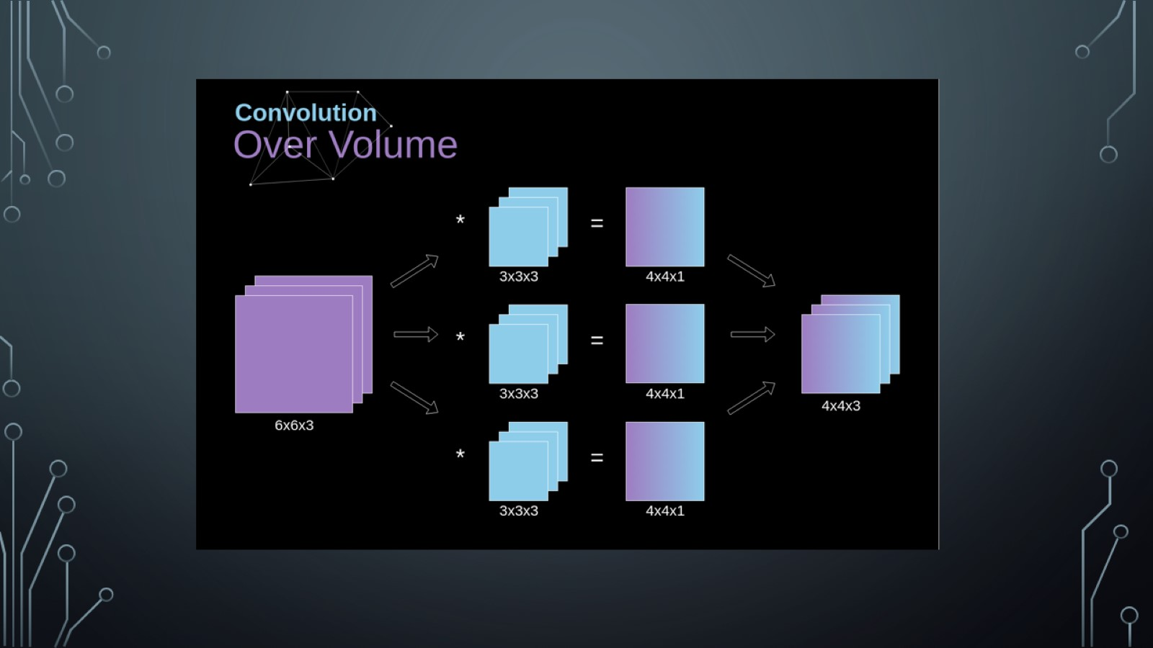

Slide 19
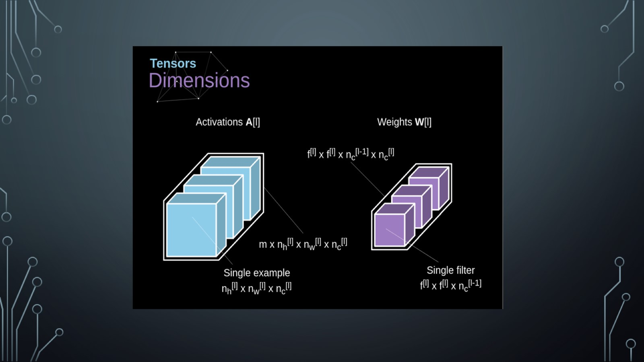

Slide 20


Slide 21
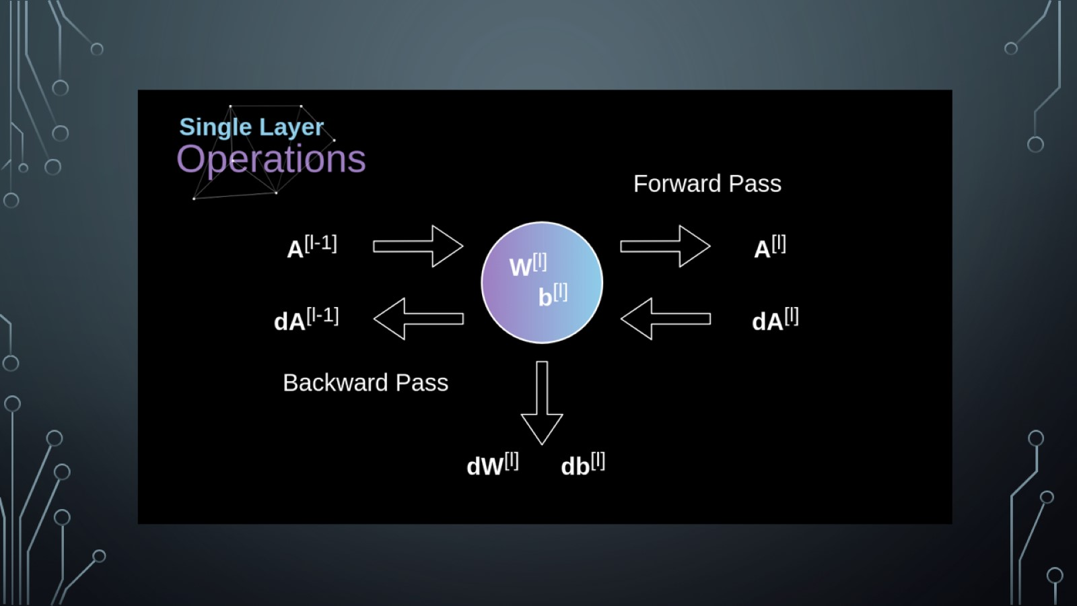

Slide 22
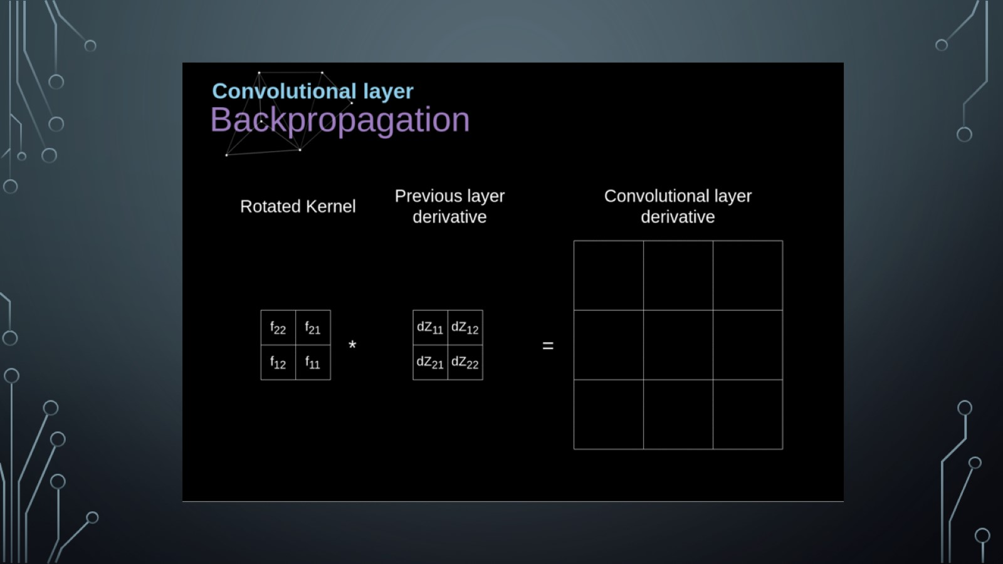

Slide 23
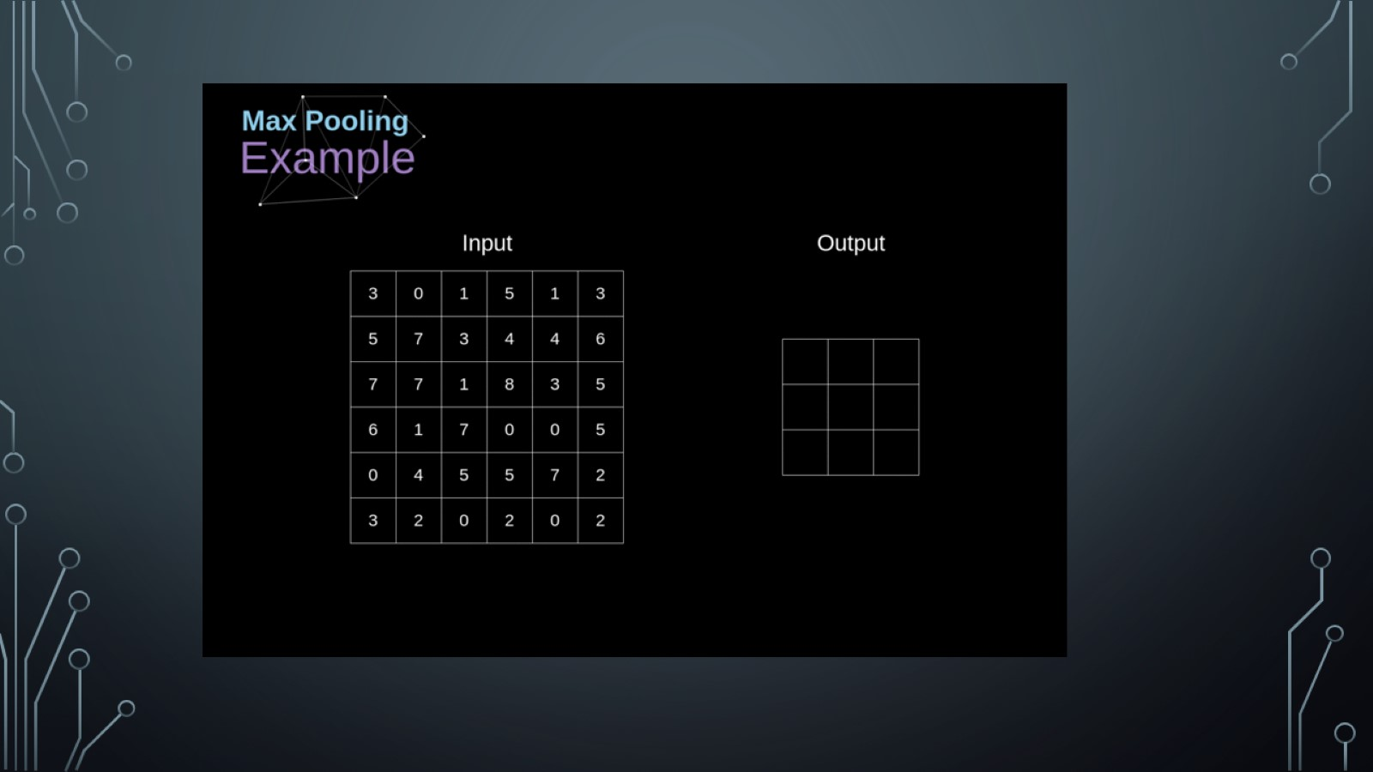

Slide 24
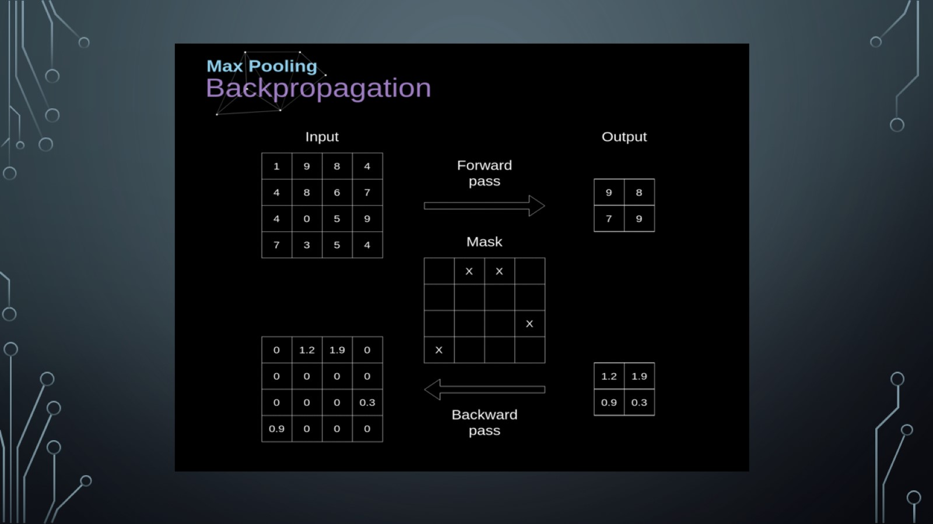

Slide 25
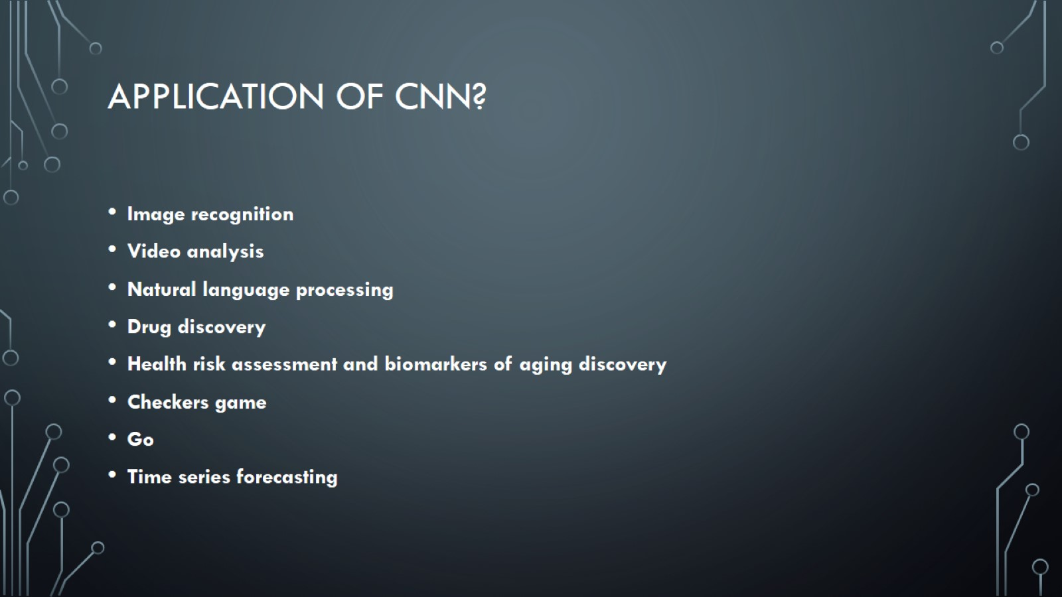
Application of Cnn?

Slide 26
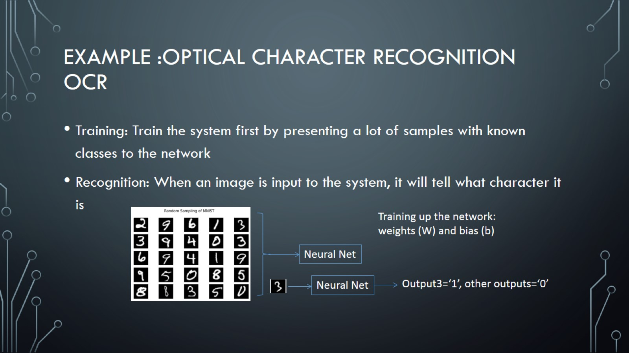
Example :Optical character recognition OCR

Slide 27
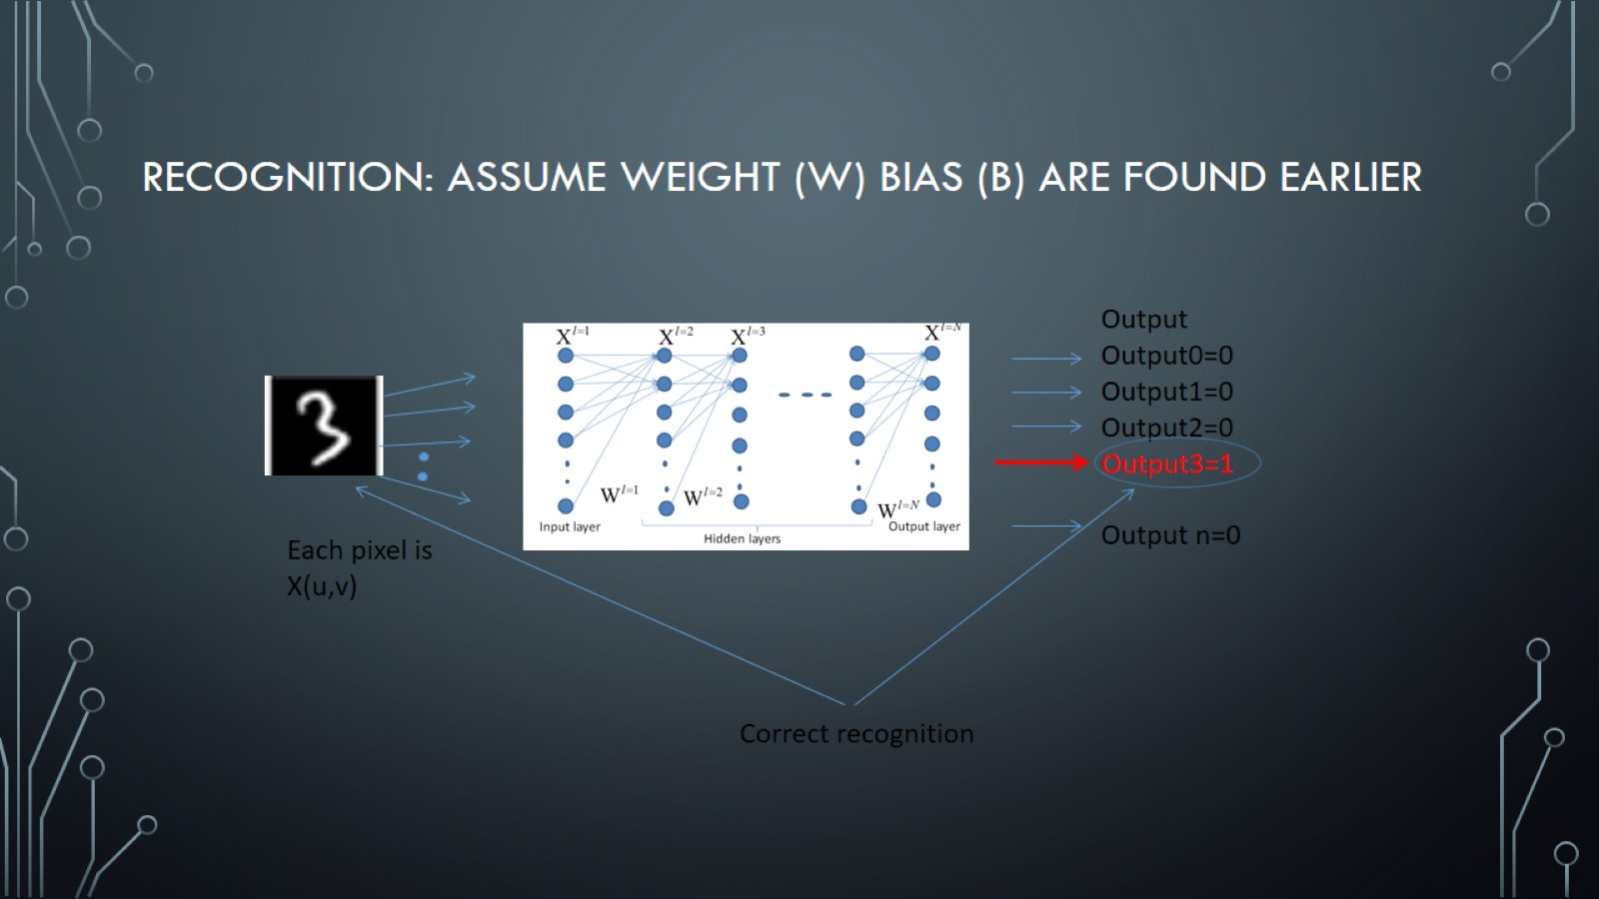
Recognition: assume weight (W) bias (b) are found earlier

Slide 28

Questions?

Slide 29

Thank You

